Slide 1

SRM INSTITUTE OF SCIENCE AND TECHNOLOGY Ramapuram Campus , Chennai – 600 089 DEPARTMENT OF COMPUTER SCIENCE AND ENGINEERING
18CSP107L-MINOR PROJECT
THYROIOD DISEASE CLASSIFICATION USING MACHINE LEARNING ALGORITHMS
BATCH NUMBER :14
Team Members | Supervisor
1.Sajid : RA2011003020203 2.Junine : RA2011003020194 3.Saikrishna : RA2011003020192 | NAME:PREETY JEMIME

Slide 2
Agenda
Abstract
Scope and Motivation
Introduction
Literature Survey ( Table)
Objective
Problem Statement
Proposed Work
Architecture Diagram/Flow Diagram/Block Diagram
Novel idea
Modules
Module Description
Software & Hardware Requirements
References (Base paper hard copy to be submitted to the supervisor.)
Way forward towards Outcome (Research Paper/Patent)

Slide 3
Introduction
Thyroid is a small, butterfly-shaped gland in the front of your neck. It makes hormones that control the way the body uses energy. These hormones affect nearly every organ in your body and control many of your body's most important functions. For example, they affect your breathing, heart rate, weight, digestion, and moods.
Thyroid diseases cause your thyroid to make either too much or too little of the hormones. Some of the different thyroid diseases include:
Goiter, an enlargement of the thyroid gland
Hyperthyroidism which happens when your thyroid gland makes more thyroid hormones than your body needs
Hypothyroidism which happens when your thyroid gland does not make enough thyroid hormones
Thyroid nodules, lumps in the thyroid gland
Thyroiditis, swelling of the thyroid
To diagnose thyroid diseases, your health care provider may use a medical history, physical exam, and thyroid test In some cases, your provider may also do a biopsy. Treatment depends on the problem, how severe it is, and what your symptoms are. Possible treatments may include medicines, radioiodine therapy, or thyroid surgery

Slide 4
ABSTRACT
Disorders of thyroid function are common, and screening, diagnosis, and management are often performed by primary care providers. While management of significant biochemical abnormalities is reasonably straight forward, laboratory tests only slightly outside, or even within, the normal range are becoming more difficult to appropriately manage. A large part of this increasing difficulty in appropriate management is caused by patients requesting, and even demanding, certain tests or treatments that may not be indicated. Symptoms of thyroid dysfunction are non-specific and extremely prevalent in the general population. This, along with a growing body of information available to patients via the lay press and internet suggesting that traditional thyroid function testing is not reliable, has fostered some degree of patient mistrust. Increasingly, when a physician informs a patient that their thyroid is not the cause of their symptoms, the patient is dissatisfied and even angry. This review aims to clarify the interpretation of normal and mild abnormalities of thyroid function tests by describing pituitary-thyroid physiology and through an in depth review of, arguably, the three most important biochemical tests of thyroid function: TSH, free T4, and anti-TPO antibodies

Slide 5
Scope and Motivation
Scope
check for hormones and proteins like antibodies and thyroglobulin. These tests can tell you if you have conditions like hypothyroidism (underactive thyroid) or hyperthyroidism (overactive thyroid). There are several types of thyroid blood tests, including TSH, T3 and T4, and thyroid antibodies
Motivation
The main motivation of doing this research is to present a thyroid disease prediction model for the prediction of occurrence of thyroid disease. Further, this research work is aimed towards identifying the best classification algorithm for identifying the possibility of thyroid disease in a patient.

Slide 6
Literature Survey
S.No. | Title of the Paper | Year | Journal/Conference Name | Inferences
1. | Expert system based on neural fuzzy rules for thyroid diseases diagnosis | 2012 | Azar, a.T, Hassanien, A.E. and Kim | The study leveraged the least absolute shrinkage and selection operator (LASSO) and LR model to select the malignant thyroid nodule-associated ultrasonic characteristics. Then, RF is applied along with a scoring system to classify the malignant thyroid nodules and acquracy of 56%.

Slide 7
2. | Machine learning applications in cancer prognosis and prediction | 2015 | Kouroua, K., Exarchosa, T.P. Exarchosa, K.P., Karamouzisc, M.V. and Fotiadisa | predicted the high probable molecules initiating the thyroid hormone homeostasis using machine learning algorithms RF, LR, GBM, SVM, and deep neural networks (DNN). The early prediction of the molecules is helpful for further testing in the first stages of thyroid disease. The molecular events were obtained from ToxCast datasets for running the experiments. The article reported that Thyroid Peroxidase (TPO) and Thyroid Hormone receptor (TR) achieved the best predictive performance with an F1 score of 0.83 and 0.81, respectively

Slide 8
S.no | Title | Authour | Year | Inference
3 | Diagnosis of thyroid disorders using artificial neural networks | Shukla, A. & Kaur | 2009 | The authors [15] evaluated the performance of the thyroid disease classification using various machine learning algorithms. SVM, RF, DT, NB, LR, K nearest neighbor (KNN), and MLP are used for disease prediction. A dataset sample of 1250 is taken from hospitals and laboratories in Iraq. The MLP predicted the thyroid classification with 96.4% accuracy.

Slide 9
S.NO | Title | Year | Authour | Inference
4 | Diagnosis of Thyroid Disease | 2016 | Dr. Srinivasan B, Pavya K | propose a data mining-based method for enhancing the precision of hypothyroidism diagnosis by integrating patient questions with test results during the diagnosis process. Another goal is to reduce the risks that come with dialysis interventional trials. The logical conclusion It was determined if the new samples were hypothyroid using data from the UCI machine learning database, which included 3163 samples, 151 of which were hypothyroid and the others were hypothyroid-97.8%
5 | Predictive Data Mining for Diagnosis of Thyroid Disease using Neural Network | 2016 | Khushboo Taneja, Parveen Sehgal, Prerana | In this paper hypothyroid disease is to be predicted using data mining. The dataset used for the study on hypothyroid is taken from UCI repository. Classification of this thyroid disease is a considerable task. An experimental study is carried out using Linear Discriminant Analysis (LDA) to achieve better accuracy

Slide 10
Objective
The quantitation of thyroid stimulating hormone (TSH) and circulating thyroid hormones in serum to assess the ability of the thyroid gland to produce and regulate thyroid hormone production.
These algorithms are used to unfold a prediction system which will analyze and predict whether the particular patient is pertaining to any thyroid disease or not. The main objective is to identify the best algorithm suitable for this, and which provides maximum accuracy.
It can analyze large amounts of patient data, including medical records, imaging tests, and genetic information, to identify patterns and predict the risk of developing heart disease.
Machine learning algorithms can also assist in identifying specific thyroid conditions, such as Hypothyroidism and hyperthyroidism are the two forms of thyroid disorders.

Slide 11
Problem Statement
The problem statement for thyroid detection using machine learning is to develop an accurate and efficient model that can diagnose thyroid disorders based on medical data and patient information.
Thyroid disorders, including hyperthyroidism and hypothyroidism, are common health issues that can have a significant impact on an individual's well-being. Early detection and diagnosis are crucial for timely treatment and management.
The goal of this project is to design a machine learning system that can analyze a patient's medical history, symptoms, and relevant diagnostic test results to predict whether they have a thyroid disorder or not.
By leveraging advanced machine learning algorithms and medical datasets, we aim to create a reliable and accessible tool for healthcare professionals to improve the accuracy and speed of thyroid disorder diagnosis, ultimately enhancing patient outcomes and quality of care.

Slide 12
Proposed Work
Proposed several machine learning models to classify thyroid disease, but none have adequately addressed this misdiagnosis problem.
Also, similar studies that have proposed models for evaluation of such disease classification mostly do not consider the heterogeneity and the size of the data.
Therefore, we propose a Decision Tree and Support Vector Machines. Machine learning and performing classifier tests based.
Advantages:
• Highest accuracy
• Reduces time complexity.

Slide 13
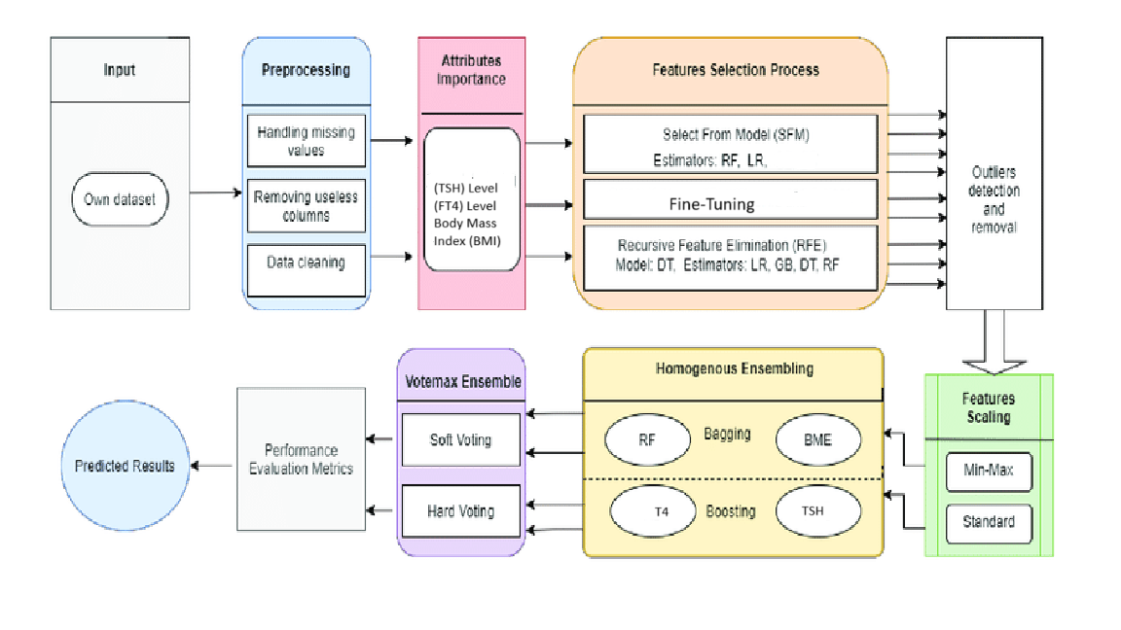
Architecture diagram

Slide 14
Software & Hardware Requirements
H/W Requirements:
Operating system : Windows 7 or 7+
RAM : 8 GB
Hard disc or SSD : More than 500 GB
Processor : Intel 3rd generation or high or Ryzen with 8 GB Ram
S/W Requirements:
Software’s : Python 3.6 or high version
IDE : PyCharm.

Slide 15
Implementation
1.Data collecting: Collecting data for thyroid detection using machine learning involves gathering a diverse and comprehensive dataset that includes various aspects of thyroid health. This dataset typically comprises a wide range of patient information, such as medical history, age, gender, family history of thyroid disorders, and lifestyle factors. In addition, it includes laboratory test results like thyroid hormone levels (T3, T4, TSH), ultrasound images of the thyroid gland, and potentially even genetic data if available.
2.Processing of data: First, relevant medical data such as patient history, symptoms, and laboratory test results are collected and organized. This data is then preprocessed to clean and standardize it, ensuring consistency and accuracy.
3.Split the Data:After the pre-processing part, the information is split into 2 batches, that are training data specifically eighty percent, and the rest is testing knowledge.

Slide 16
Implementation
4.Training the data: In training model the algorithm learns to recognize patterns and relationships within the data that indicate the presence of thyroid disorders. The model's performance is evaluated using metrics such as accuracy, sensitivity, specificity, and F1-score to ensure its reliability and effectiveness.
5.Testing the Model: This process involves subjecting the ML model to rigorous assessments to evaluate its accuracy, reliability, and overall performance. To begin, a diverse and representative dataset of thyroid-related medical records, including patient histories and diagnostic test results, is used to train the model. Subsequently, the model is fine-tuned and optimized through various iterations to enhance its predictive capabilities.
6.Implementing the model : Implementing a model for thyroid detection using machine learning is a complex and crucial endeavor in the realm of medical diagnostics. This process involves the utilization of advanced algorithms and techniques to analyze medical data, typically derived from various sources such as blood tests, ultrasound scans, and patient histories.

Slide 17
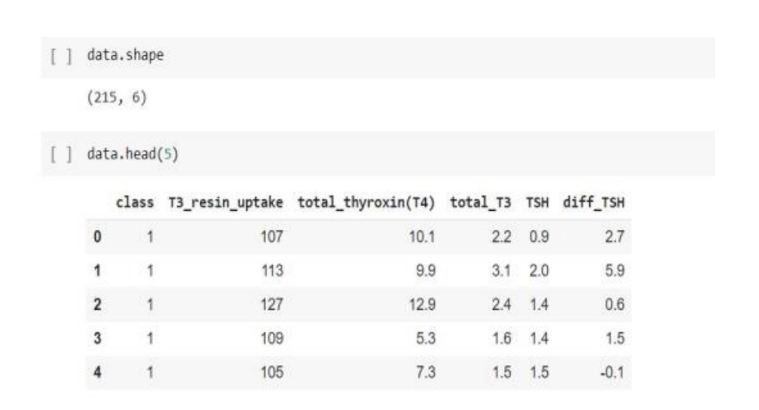
Figure 4.7: Pre processing of Data

Slide 18
DATASETS SAMPLE
Class | Hyper-Parameters | Tuning Range
LR | solver = liblinear, C = 5.0 | solver = {liblinear, saga, sag}, C = {1.0 to 8.0}
SVM | kernel = ‘linear’, C = 5.0 | kernel = {‘linear’, ‘poly’, ‘sigmoid’} C = {1.0 to 8.0}
RF | n_estimators = 200, max_depth = 20 | n_estimators = {10 to 300}, max_depth = {2 to 50}
GBM | n_estimators = 200, max_depth = 20, learning_rat = 0.5 | n_estimators = {10 to 300}, max_depth = {2 to 50}, learning_rat = {0.1 to 0.9}
ADA | n_estimators = 200, max_depth = 20, learning_rat = 0.5 | n_estimators = {10 to 300}, max_depth = {2 to 50}, learning_rat = {0.1 to 0.9}

Slide 19
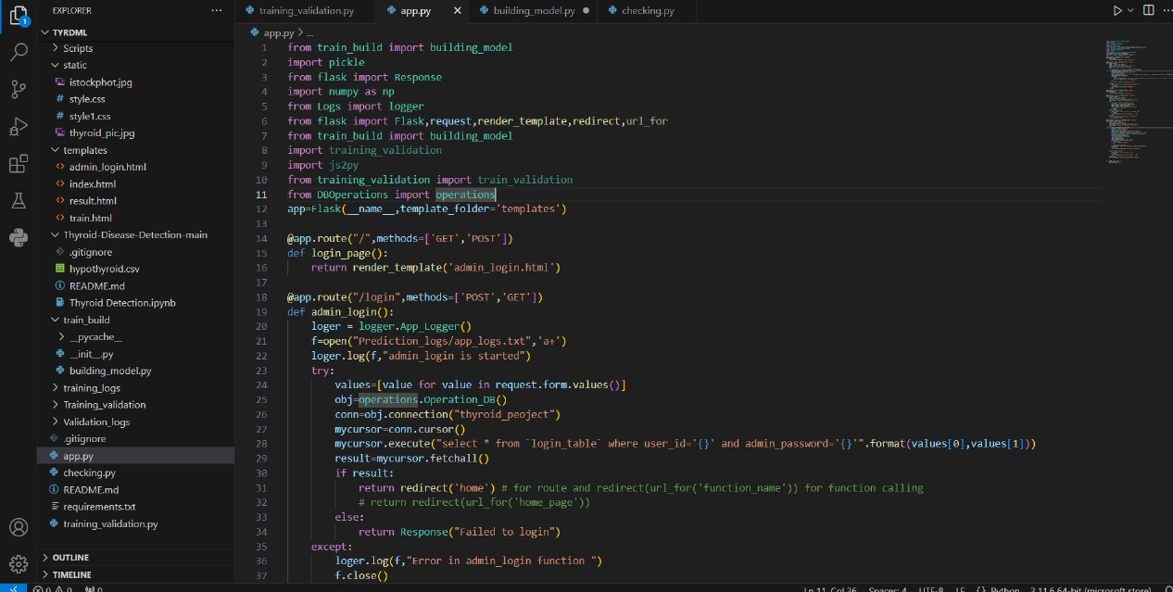

Slide 20
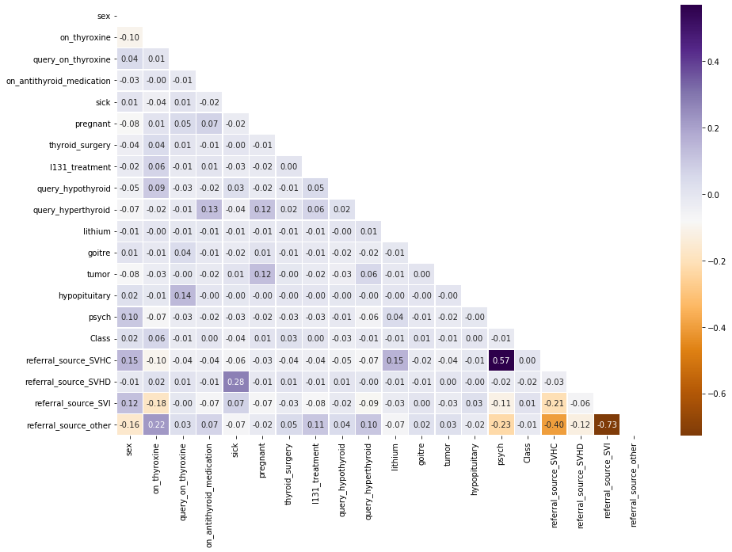

Slide 21
References
1. Shrivas A., Ambastha P. An ensemble approach for classification of thyroid disease with feature optimization. International Education and Research Journal . 2019;3(5):1–4.
2. Chaubey G., Bisen D., Arjaria S., Yadav V. Thyroid disease prediction using machine learning approaches. National Academy Science Letters . 2021;3:128–133. doi: 10.1007/s40009-020-00979-z.
3. Dewangan A., Shrivas A., Kumar P. Classification of thyroid disease with feature selection technique. International Journal of Engineering & Technology . 2016;2(3):128–133.
4. Begum A., Parkavi A. Prediction of thyroid disease using data mining techniques. International Conference on Advanced Computing & Communication Systems (ICACCS); 2019; Coimbatore, India. pp. 342–345.
5. Moon J. H., Steinhubl S. Digital medicine in thyroidology: a new era of managing thyroid disease. Endocrinology and Metabolism . 2019;34(2):124–131. doi: 10.3803/EnM.2019.34.2.124.

Slide 22
Outcome
The outcome of this project holds significant potential.
It primarily aims to save lives by predicting thyroid disease in individuals at risk and enabling early intervention.
By using machine learning techniques and comprehensive datasets, the system can provide accurate predictions based on vital clinical and demographic data, including factors like dry skin, elevated temperature sensitivity, hair thinning, weight loss, increased heart rate, high blood pressure, heavy sweating.
This system's successful implementation would not only improve patient outcomes but also contribute to reducing healthcare costs by identifying those in need of medical attention.

Slide 23
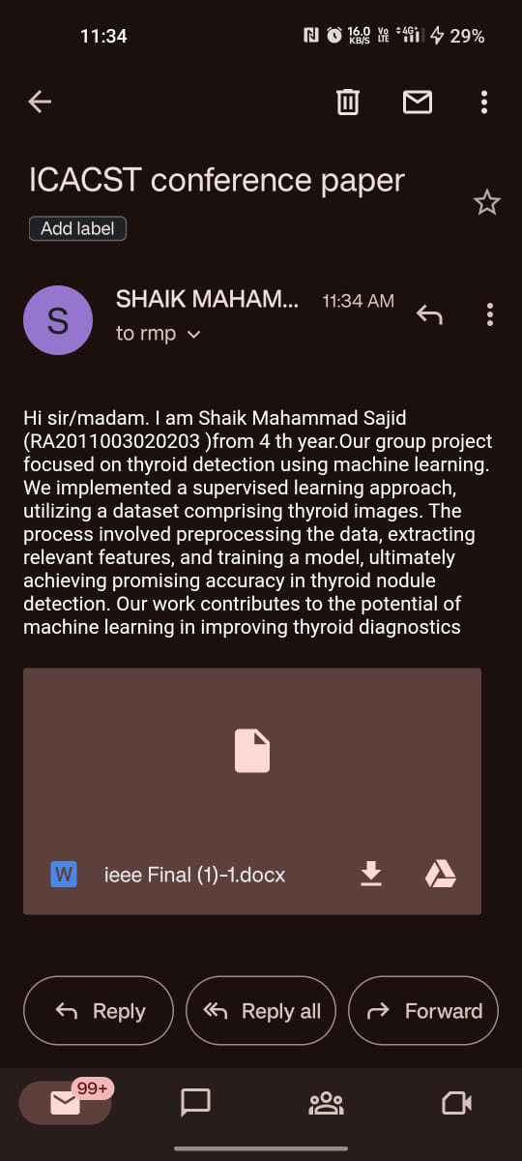
Applied at ICASC (SRM Institue Of Science And Technology)

